Slide 1
WELCOME TO OUR MATH CLASS!
Mrs. Cheatham Math 7 & Math 8

Slide 2
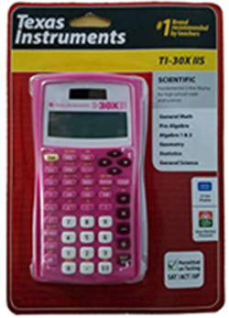
MATH SUPPLIES NEEDED
Binder (1 inch)
Loose-leaf Paper
Sharpened Pencils
with Good Erasers
(No Pens)
Colored Pencils
Highlighter
Small Pencil Sharpener
Supply Pouch
Calculator (TI-30X IIS or TI-84 Plus CE for High School)
Graph Paper (8th)
Straight Edge/Ruler (8th)
Donation Requests:
Index Cards
Black Expos

Slide 3
Essentials for Class Success
Attendance
Do not miss school unless absolutely necessary!
Absent? Use Weekly Checklist & Google Classroom

Slide 4
Essentials for Class Success
Weekly Checklist
Delivered on Monday (Hard Copy for Student & Emailed to Families)
Lists all Assignments for Given Week

Slide 5
Essentials for Class Success
Google Classroom
Updated Daily with Lesson Materials (Lesson Videos, Needs Materials, etc.)
2022-2023 Class Codes below:

Slide 6
Essentials for Math Class Success
Complete and check your Homework each night. Rewatch the lesson from the class video if necessary!
If you have trouble with your Homework, you are responsible for getting the help you need.
Email Mrs. Cheatham for Quick Questions
Tutoring before (7:15) or after school (until 3:45)
Engage in the Daily Lesson.
Prepare and practice for all Assessments!
Own your Understanding!
Class Motto: FIND A WAY!

